Slide 1




ML/DL for Everyone with
Lecture 1:Overview
Sung Kim <hunkim+ml@gmail.com> HKUST
Code: https://github.com/hunkim/PyTorchZeroToAll
Slides: http://bit.ly/PyTorchZeroAll

Slide 2

Call for Comments
Please feel free to add comments directly on these slides.
Other slides: http://bit.ly/PyTorchZeroAll
Picture from http://www.tssablog.org/archives/3280

Slide 3
ML/DL for Everyone with
Lecture 1:Overview
Sung Kim <hunkim+ml@gmail.com> HKUST
Code: https://github.com/hunkim/PyTorchZeroToAll
Slides: http://bit.ly/PyTorchZeroAll

Slide 4

What is ML?

Slide 5

What is Human Intelligence?

Slide 6

What is Human Intelligence?
What to eat for lunch?
Information

Slide 7

What is Human Intelligence?
What to eat for lunch?
Information
Infer

Slide 8
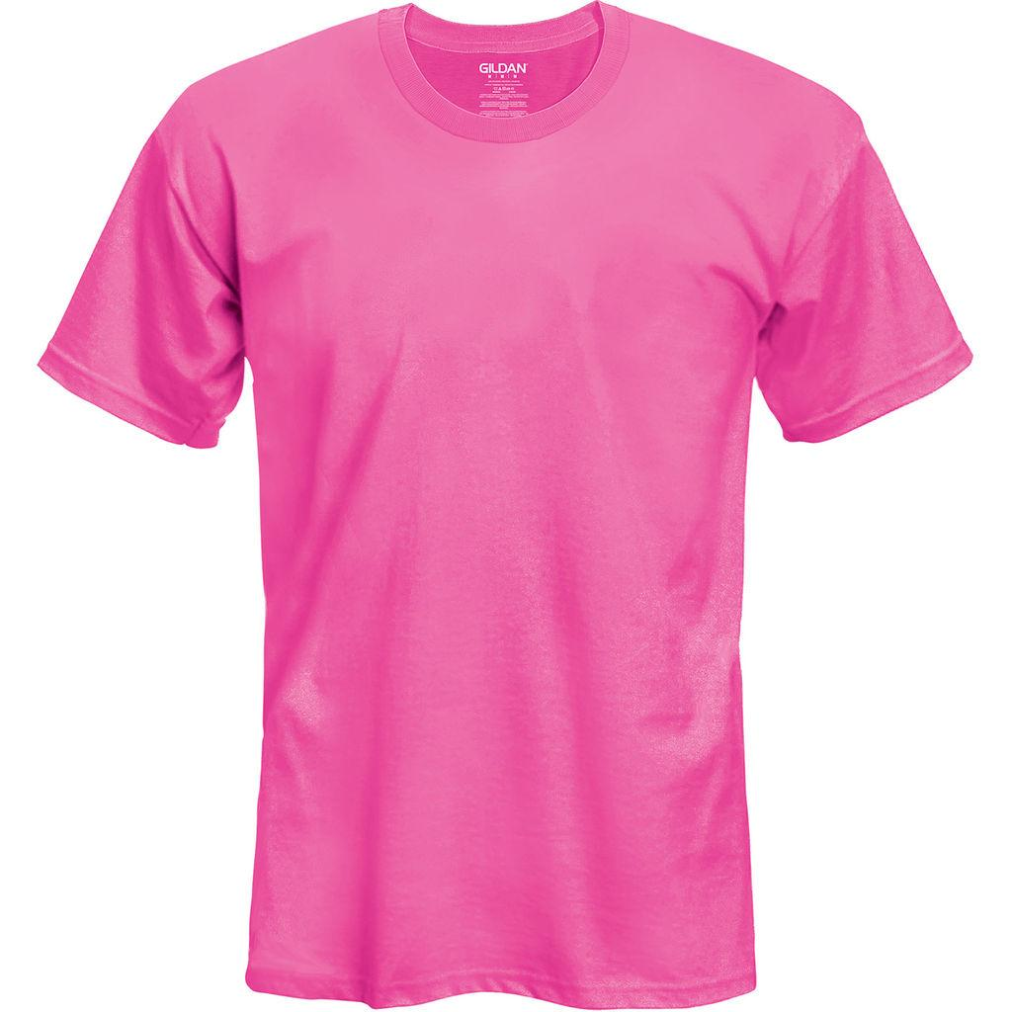
What is Human Intelligence?
What to dress?
Information
Infer

Slide 9
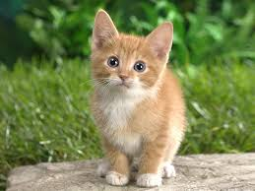
What is Human Intelligence?
What is this picture?
CAT
Image information
Prediction

Slide 10

What is Human Intelligence?
What is this number?
2
Image information
Prediction

Slide 11
What is Human Intelligence?
What would be the grade if I study 4 hours?
4 hours
? points
information
Prediction

Slide 12
Machine Learning
What to dress?
Information
Infer

Slide 13
Machine Learning
What is this picture?
CAT
Image information
Prediction

Slide 14
Machine Learning
What is this number?
2
Image information
Prediction

Slide 15
Machine Learning
What would be the grade if I study 4 hours?
4 hours
? points
information
Prediction

Slide 16
Machine Learning
Machine need lots of training
2
Image information
Prediction

Slide 17

Machine Learning
Machine need lots of training
Model
training
Labeled dataset

Slide 18
Machine Learning
Predict (test) with trained model
2
Image information
Prediction
Test dataset
Trained model

Slide 19
Machine Learning
What would be the grade if I study 4 hours?
4 hours
? points
Prediction
Hours (x) | Points (y)
1 | 2
2 | 4
3 | 6
4 | ?
Training dataset
Test dataset

Slide 20

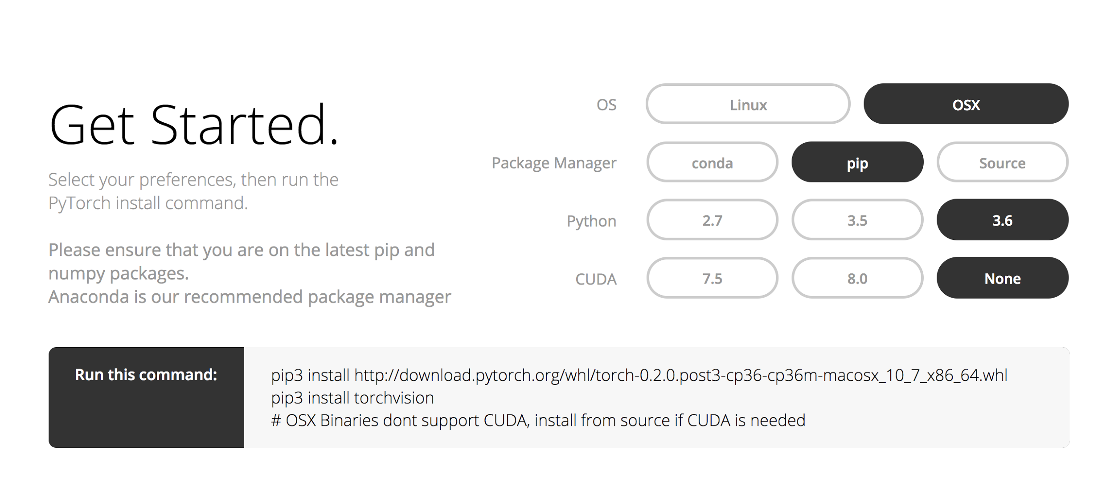
Install

Slide 21


Lecture 2:
Linear Model

